Slide 1


Machine Learning

Slide 2
t
Agenda
01
Introduction
02
Most Frequent Site
03
Months statistics
04
Rush Hour
05
Time series

Slide 3
Introduction

Slide 4
Introduction
A web server log file is a text file that is written as activity is generated by the web server. Log files collect a variety of data about information requests to your web server. In this project the logfile is the URLS provided in the CSV. The most frequent site were found and the rush hours in months. Arima were used for the prediction.

Slide 5
Most Frequent Site

Slide 6
Most Frequent Site
Most frequent site turned out to be the login page which has the following url:
GET /login.php HTTP/1.1

Slide 7
Months Statistics

Slide 8
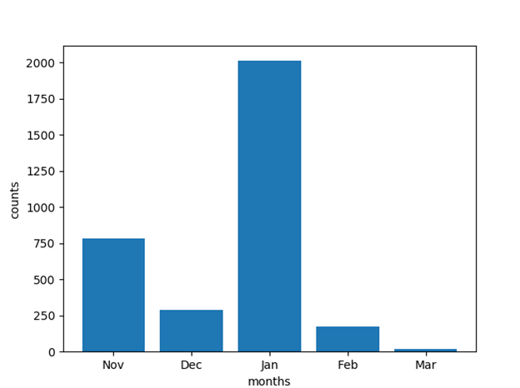
Months Statistics
Months were considered for the time range for simplicity and counts are the number of frequent site during these months.
January has the longest bar which specifies that the most frequent web page were opened the most maximum time during this month.
March has the smallest bar that explains that the web page were opened the less number of times during this month.

Slide 9
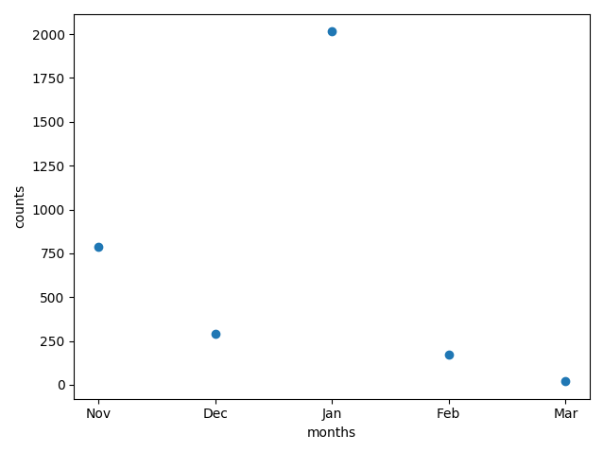
Scatter Diagram
Representing the number of accessing the most frequent url in each month

Slide 10
Rush Hour

Slide 11
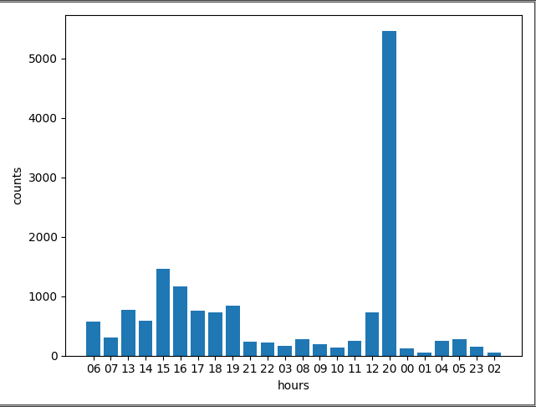

Rush Hour
This histogram is representing the number of accessing the most frequent site at every hour on the whole dataset, from this diagram we can tell that the rush hour is 20 as it has got the most visits.

Slide 12
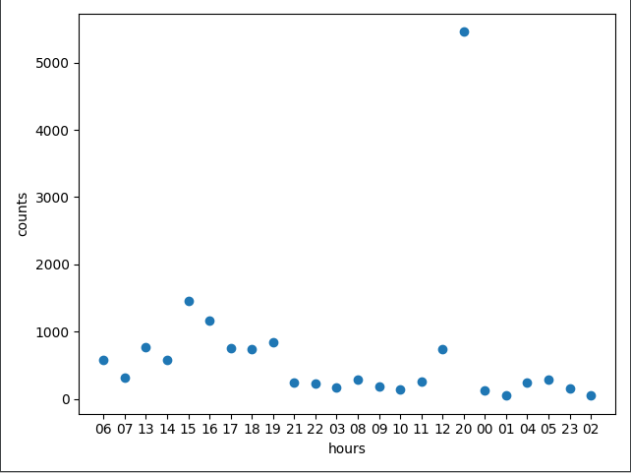
Scatter Diagram
The scatter diagram shows the rush hours of the most frequent site during each hour in a day. As shown in the graph the website has been opened the most at 20:00 which is much above than the rest of the times during the the day.

Slide 13
Time Series

Slide 14
Time Series
ARIMA
ARIMA is an acronym that stands for AutoRegressive Integrated Moving Average. It is a class of model that captures a suite of different standard temporal structures in time series data.
An ARIMA model is a class of statistical models for analyzing and forecasting time series data. Parameters used and assumptions are made by the model itself.
A method among several used in forecasting variables.
Using the information obtained from the variables.
The variables is regressed on its own past values.
Based on univariate analysis.
Knowing and analysing the probabilistic, or stochastic, properties of values.
Designed to forecast future movements.

Slide 15
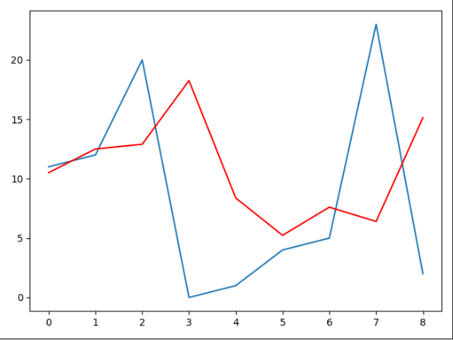
Comparison of prediction and expected one
The red line indicates the predicted one and the blue line indicates the expected and the distance between them indicates the error.

Slide 16
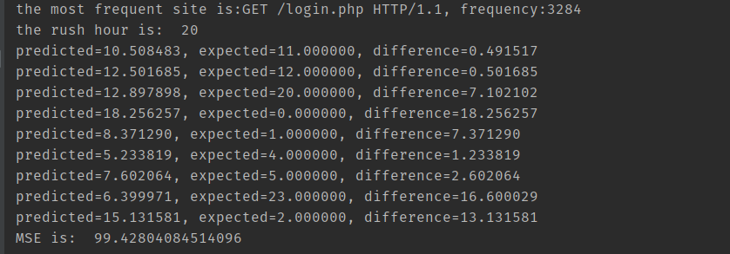
Output

Slide 18
Thank You

